Slide 1




Power Your College Experience and Career
with the Project Management Institute (PMI)
and PMI, Pikes Peak Regional, Colorado

Slide 2

We believe in the power of
Rising Leaders.
The Project Management Institute and PMI Pikes Peak Region, Colorado are excited to help Rising Leaders like YOU to:
Deliver positive impact by providing the right tools, skills and community to become effective project managers in any career path.
Magnify your abilities, connect your ambition with a global network and offer you opportunities to build confidence and take action.

Slide 3

Perks of Project Management Institute (PMI) Student Membership include:
PMI Membership discounts along with discounts on these courses and certifications:
Certified Associate in Project Management (CAPM®) exam
PMI Certifications. Based on rigorous standards and research to meet the real-world needs of organizations.
Online courses. Student members receive discounts of up to 30% in every area of project and program management.
PMI Kickoff
Free, 45-minute digital course and tool kit guiding
you through the basics of project management
Visit PMI.org/membership/student and start your journey as a Rising Leader for only $32!

Slide 4
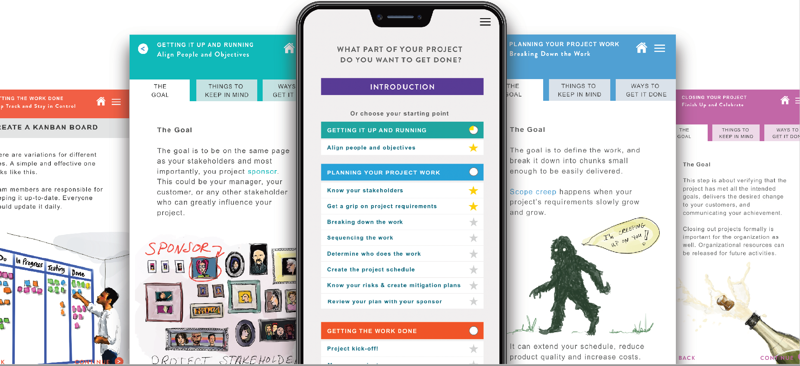

Kickoff
Kickoff is a free digital learning tool offered by the Project Management Institute with student membership that gets informal project managers and rising leaders quickly up-to-speed through a 45-minute crash course in project management.
Get smarter with foundational knowledge that’s critical for project success.
Put learnings into practice immediately—so you can move your project forward.
Learn how to rally and inspire a team you can trust to get the job done.
Gain new skills that can make you a more confident professional leader.

Slide 5

Questions?
PMI Pikes Peak Regional, Colorado is here to help!
Chat with Frank Tank, VP of Professional Development, or email him at VP_pd@pmipprc.org

